Slide 1
Objects
Lesson 1.3

Slide 2

Red Velvet Cupcakes with Cream Cheese Frosting
outputs
Ingredients (inputs)
2 1/2 cups all-purpose flour
1 1/2 cups sugar
1 teaspoon baking soda
1 teaspoon salt
1 teaspoon cocoa powder
1 1/2 cups vegetable oil
1 cup buttermilk, room temperature
2 large eggs, room temperature
2 tablespoons red food coloring
1 teaspoon white distilled vinegar
1 teaspoon vanilla extract
pound cream cheese, softened
2 sticks butter, softened
1 teaspoon vanilla extract
4 cups sifted confectioners' sugar
Chopped pecans and fresh raspberries or strawberries, for garnish
Directions (steps)
Preheat the oven to 350 degrees F. Line 2 (12-cup) muffin pans with cupcake papers.
In a medium mixing bowl, sift together the flour, sugar, baking soda, salt, and cocoa powder
In a large bowl gently beat together the oil, buttermilk, eggs, food coloring, vinegar, and vanilla with a handheld electric mixer.
Add the sifted dry ingredients to the wet and mix until smooth and thoroughly combined.
Divide the batter evenly among the cupcake tins about 2/3 filled.
Bake in oven for about 20 to 22 minutes, turning the pans once, half way through.
Test the cupcakes with a toothpick for doneness. Remove from oven and cool completely before frosting.
In a large mixing bowl, beat the cream cheese, butter and vanilla together until smooth.
Add the sugar and on low speed, beat until incorporated. Increase the speed to high and mix until very light and fluffy.
Garnish with chopped pecans and a fresh raspberry or strawberry.
Cook's Note: Frost the cupcakes with a butter knife or pipe it on with a big star tip.
[Sources: www.foodnetwork.com, office.com]

Slide 3
Red Velvet Cupcakes with Cream Cheese Frosting
More objects
outputs
Ingredients (inputs)
Red Velvet Cupcakes
2 1/2 cups all-purpose flour
1 1/2 cups sugar
1 teaspoon baking soda
1 teaspoon salt
1 teaspoon cocoa powder
1 1/2 cups vegetable oil
1 cup buttermilk, room temperature
2 large eggs, room temperature
2 tablespoons red food coloring
1 teaspoon white distilled vinegar
1 teaspoon vanilla extract
Cream Cheese Frosting
1 pound cream cheese, softened
2 sticks butter, softened
1 teaspoon vanilla extract
4 cups sifted confectioners' sugar
Chopped pecans and fresh raspberries or strawberries, for garnish
Directions (steps)
Red Velvet Cupcakes
Preheat the oven to 350 degrees F. Line 2 (12-cup) muffin pans with cupcake papers.
In a medium mixing bowl, sift together the flour, sugar, baking soda, salt, and cocoa powder
In a large bowl gently beat together the oil, buttermilk, eggs, food coloring, vinegar, and vanilla with a handheld electric mixer.
Add the sifted dry ingredients to the wet and mix until smooth and thoroughly combined.
Divide the batter evenly among the cupcake tins about 2/3 filled.
Bake in oven for about 20 to 22 minutes, turning the pans once, half way through.
Test the cupcakes with a toothpick for doneness. Remove from oven and cool completely before frosting.
Cream Cheese Frosting
In a large mixing bowl, beat the cream cheese, butter and vanilla together until smooth.
Add the sugar and on low speed, beat until incorporated. Increase the speed to high and mix until very light and fluffy.
Garnish with chopped pecans and a fresh raspberry or strawberry.
Cook's Note: Frost the cupcakes with a butter knife or pipe it on with a big star tip.
One object
One function
Another function
Another object
[Sources: www.foodnetwork.com, office.com]

Slide 4
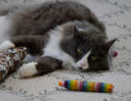
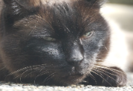
Cat objects
age
6
An object
weight
7
grumpiness
1
A property
age
19
weight
8
Another object
grumpiness
9

Slide 5
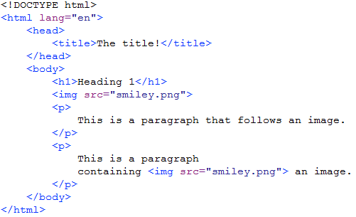
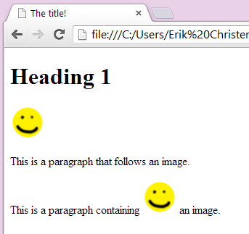
Image object
Image object
width
47
height
46
(etc)

Slide 6
(Image Object in Chrome)

Slide 7
Exercises 1 – 5
Exercise 1
Shows you how
Exercise 2
You do
Exercise 3
Shows you more
Exercise 4
You do more
Exercise 5 (optional)
You experiment

